Slide 1

NIC002 & Theranos
Potential Applications and Benefits
[redacted], MD
This presentation contains THERANOS confidential information

Slide 2
Real Time Ambulatory ELISA Measurements

Slide 3
Measurement of Anti-Nicotine Antibodies
More frequent ambulatory monitoring to obtain more comprehensive time-series
Enrichment of PK/PD modeling
More precise identification of optimal antibody-threshold for target quit date (enhancement of success of quitting)
More precise identification of optimal antibody-threshold for booster (relapse prevention)
Individualized Medicine
Need for additional dose and/or booster determined at patient level to bring everyone to high titer level and expand total user market
Real time data integrated into clinical trial management system
Supportive for adaptive seamless design studies
3 | Presentation Title | Presenter Name | Date | Subject | Business Use Only

Slide 4
Measurement of Nicotine in Blood
Bound nicotine will remain in the blood much longer than free nicotine
Detection of Nicotine will cover a protracted period of time (the “HbA1c of smoking cessation”)
Harder and more convincing data relative to response
Reinforcement of patients compliance
No need for additional assessment technology (CO from exhaled air)
One drop of blood sufficient for all tests, which will be loaded on one cartridge
Harder data
4 | Presentation Title | Presenter Name | Date | Subject | Business Use Only

Slide 5
Real-time ambulatory measurement of key analyte (antibodies) concentrations simultaneously with other measurements
Identify optimal dose – Monitor more frequently to obtain more comprehensive time-series measurements
Database automatically integrates time-series measurements with other data points (patient record, patient diary, etc.) to provide better ‘map’ of efficacy than isolated “snapshot” blood measurements.
Graphical portrayal of integrated data set allows for better extraction of actionable information
Strengthen efficacy monitoring through measurement of nicotine (or cotinine) levels simultaneously with main assessment (antibodies)
5 | Presentation Title | Presenter Name | Date | Subject | Business Use Only

Slide 6
Summary
Measure the titer of individual sera to determine the effect of the vaccine and ensure an individual has properly been inoculated.
Monitor the effect of free nicotine in test subjects in real-time before it is cleared by the kidneys - thus proving efficacy of the treatment directly
Screen subjects to aid in selecting responders (high titer levels) for trial
Same systems works for any user of tobacco products (smokeless tobacco …)
6 | Presentation Title | Presenter Name | Date | Subject | Business Use Only

Slide 7
Remote Interaction with Patients

Slide 8
Portal to Enhance Remote Interactions with Patients
Engage patients in managing their dependence
Integration of customized smoking cessation programs
Captures data in an ambulatory setting reducing requirements of patients to return to the clinic enabling early, adaptive and rapid decision making
Fully integrated data infrastructure for support of adaptive seamless design studies
Link to monitoring data allows for enhanced compliance and clinical success
Reinforcement of patient compliance to aid in the management of their own disease
Direct interaction between physician and patient (two ways) during drug development and post-marketing
8 | Presentation Title | Presenter Name | Date | Subject | Business Use Only

Slide 9
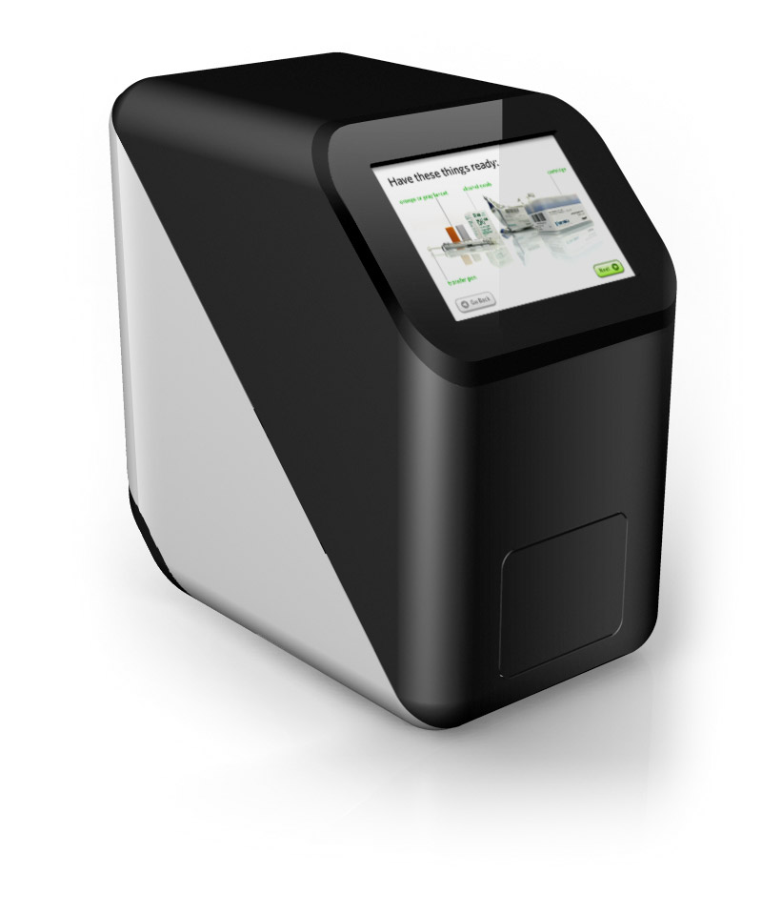
The Theranos System: Remote Interaction
Friendly User Interface
Readers have web-standards based touch screens
These screens are dynamically fed with content in real-time
Collects data through graphical touch-screen input
Modes for different visual needs, e.g., “High Contrast,” “Large Buttons”
Dynamic, updateable content
Surveys fed and retrieved from server
Additional content can be generated or modified at any time
9 | Presentation Title | Presenter Name | Date | Subject | Business Use Only

Slide 10
The Theranos System: Behavior Modification
Theranos strives to change patients’ behavior to enable long-term, healthy living through targeted content
Class-based content is delivered based on patients’ goals, protein levels, and their survey feedback
Patient classes are identified at program initiation
Content is individualized with streamlined information that touches individuals’ predispositions and mindsets
Content is based on informatics performed on integrated data sets & tied to patient class and progress as shown through the monitoring data, and is derived from Theranos Human Centered Design team with a link to the Nicotine Dependence Center at Mayo Clinic
It represents leading psychological approaches to smoking cessation motivation and therapy, delivered in small, memorable chunks.
10 | Presentation Title | Presenter Name | Date | Subject | Business Use Only

Slide 11
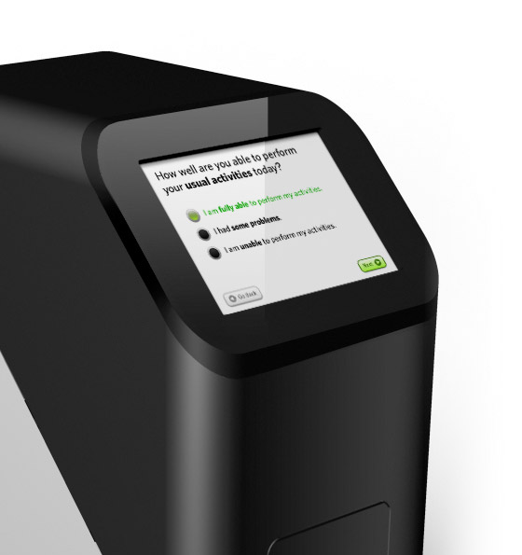
Next generation GUI based patient programs
Increased Compliance with a Program
Ease of Use - a graphical touch-screen uses simple symbolic input
Cognitive demand is reduced giving patients a higher level of satisfaction
Theranos readers can be used at home where patients are most comfortable
Programs are individualized
11 | Presentation Title | Presenter Name | Date | Subject | Business Use Only

Slide 12
The Theranos System: Benefits
The Theranos approach allows patients to manage their own disease and gives targeted feedback about their progress
Targeted, class-based content engages patients in managing their own dependence
Direct interaction between physician and patient (two ways) during drug development and post-marketing
Theranos enables early detection, with rapid and adaptive treatment strategies
Survey API supports adaptive, seamless design studies
Clinic can adjust survey or content through XML
Open data infrastructure provides full integration with other systems
Can link data with other monitoring data, such as other assays or research metrics from other aspects of study
Patients are more likely to provide honest data because Theranos Readers analyze biological markers as well as survey data
12 | Presentation Title | Presenter Name | Date | Subject | Business Use Only

Slide 13
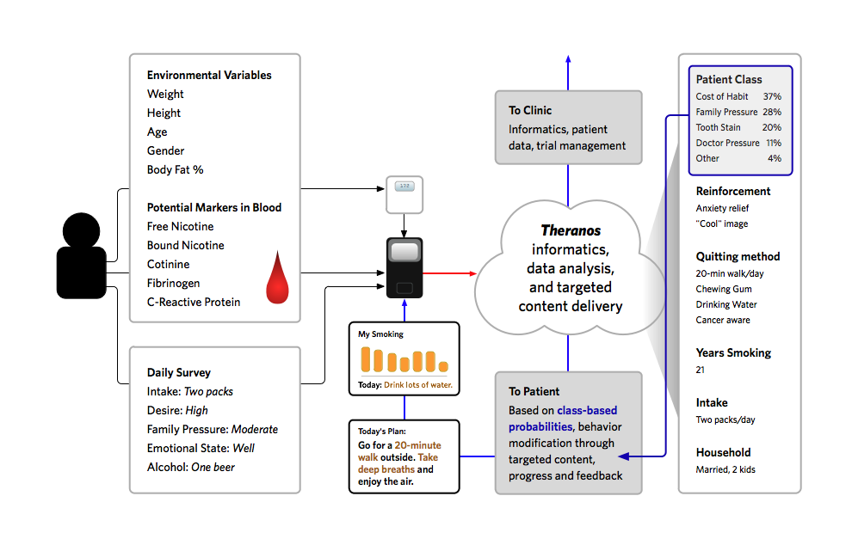
The Theranos System: Case Study
13 | Presentation Title | Presenter Name | Date | Subject | Business Use Only

Slide 14
Applications – Initial Thoughts

Slide 15
Drug Development
Optimization of dose regimen
Enriched PK/PD model
Identification of key antibody thresholds for smoking cessation and for relapse prevention
Could number of initial injections be reduced in individual patients/subgroups?
Identification of TQD with enhanced PoS
Identification of optimal time point for booster
Supportive of adaptive seamless design
[More] Robust clinical efficacy assessments
Direct Nicotine levels assessments
Full integration of smoking cessation programs
Delivered directly through portal associated with the device
Less dependence on site specific interactions
15 | Presentation Title | Presenter Name | Date | Subject | Business Use Only

Slide 16
Post-Marketing
Unique integrated drug-program combo
Competitive advantage
Basic smoking cessation program won’t be replaced by silver bullet drug and will remain key component of any quitting attempt
→[redacted] to deliver full package
Consumer point of care system has ability to serve as a companion to the vaccine pre and post-approval to serve as definitive differentiator from competition
Personalized medicine
Optimized regimen
Administration of most appropriate number of injections and optimized timing
Enhanced clinical outcome
Better reimbursement from payers?
Enhanced reproducibility of clinical studies data in real world
Less dependence on physician background
Less experienced physicians would still be able to administer both injection and smoking cessation program
16 | Presentation Title | Presenter Name | Date | Subject | Business Use Only

Slide 17
Next Steps

Slide 18
Validation
Theranos to develop and validate assays
MSA incorporates MTA
MSA signature
Theranos SOW for Phase A includes detailed material request
Material transfer desired by 12/31/07 – latest 1/15/08 for desired development lead time
[redacted] to determine best opportunities for validation
E.g. PoC patients (subgroup)
Blood samples to be provided to Theranos prior to June study initiation
June study run with at home monitoring and in clinic testing
Discussions on partnership
January meeting
18 | Presentation Title | Presenter Name | Date | Subject | Business Use Only

Slide 19
Back Up

Slide 20
Development of Nicotine Assay
1) Measuring the titer of human anti-nicotine.
a. A supply of nicotine that is used as the vaccine. 5 to 10 mgs
b. A larger supply of nicotine conjugated to another protein to be used as the capture. 10 to 20 mgs to start with.
c. As many human anti-vaccine samples as we can get. (25 + samples and several mls of each for Positive controls.
d. If there exist a Monoclonal or Polyclonal sera to the conjugate.
2) Measuring nicotine levels in sera.
a. Monoclonal or Polyclonal purified IgG specific for Nicotine,
b. Nicotine conjugated to different carrier than vaccine in order to be conjugated to AP.
20 | Presentation Title | Presenter Name | Date | Subject | Business Use Only

